Slide 1


Daily CSI
Spot the Differences
Golden Treasure
8th Grade Forensic Science
T. Trimpe 2008 http://sciencespot.net/

Slide 2
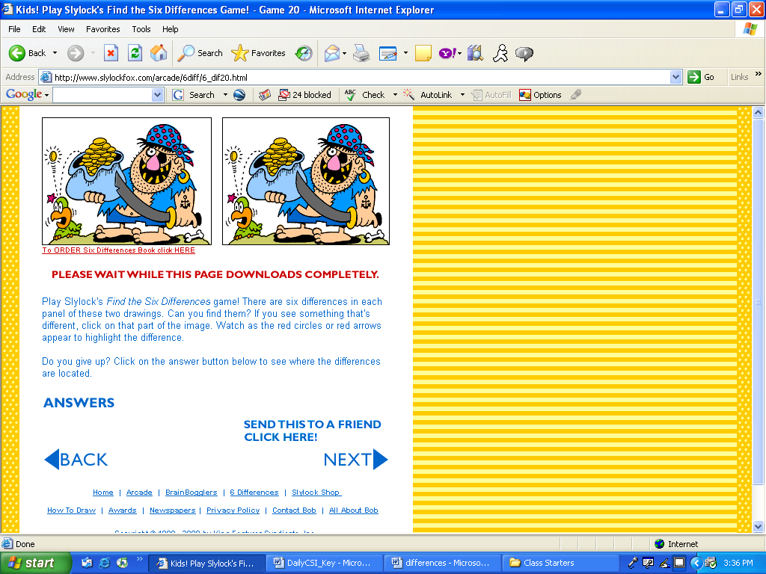
Find the 6 differences between the two pictures.
Source: http://www.slylockfox.com/arcade/6diff/index.html

Slide 3
The answers are …
Answers: Missing coin, belly button, tooth,
shirt hem, sword, missing polka dot
Source: http://www.slylockfox.com/arcade/6diff/index.html

